Slide 1
Midterm Proposal
Hanna Rinderknecht-Mahaffy

Slide 2
Concept
For my midterm project, I plan to create a multi-page informational website about the impacts of animal agriculture on the environment. The site pages will include:
An about page
Facts about the different areas of environmental impact
Ways to reduce this impact

Slide 3
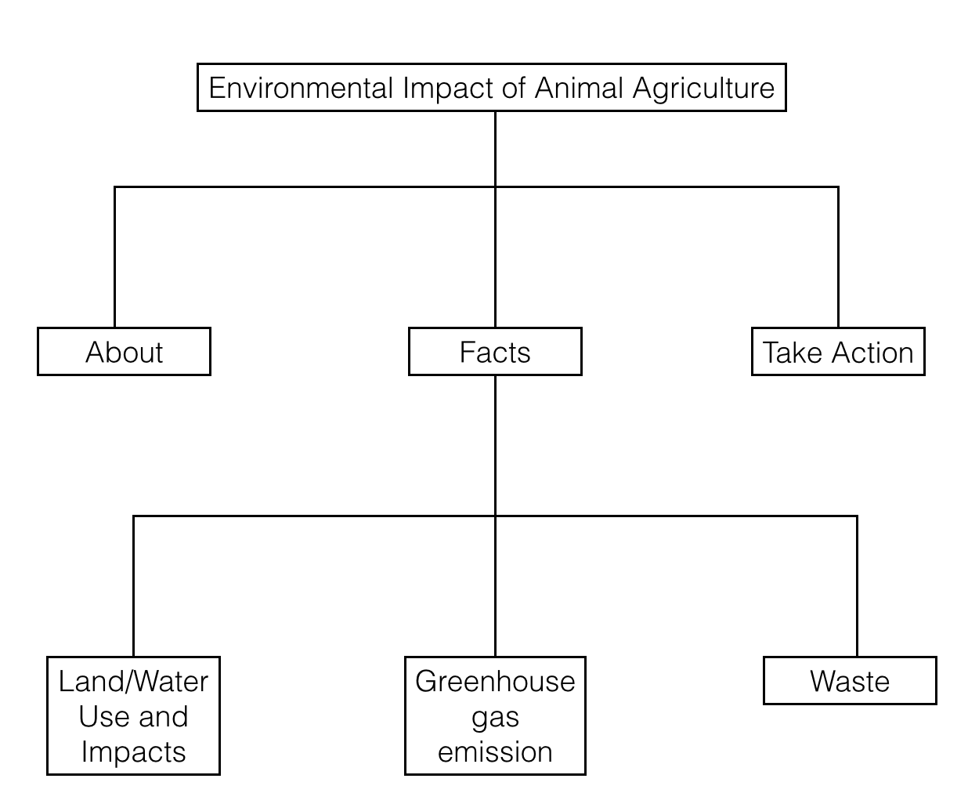
Site Map

Slide 4
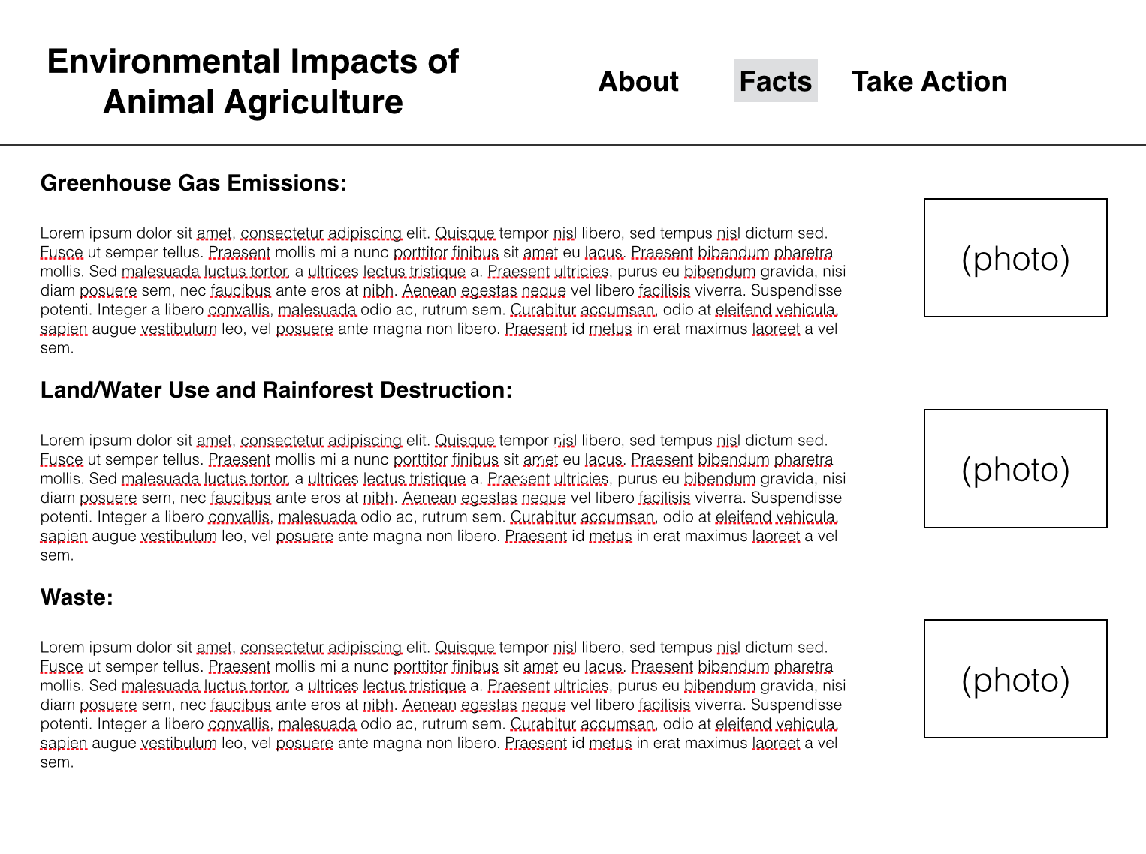
Wireframe

Slide 5
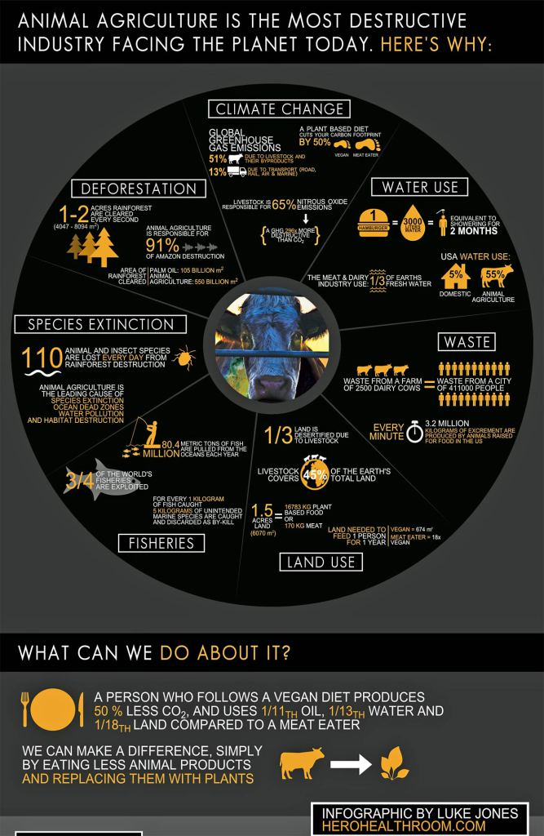
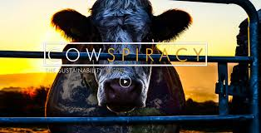
Inspiration:

Slide 6
Concepts
Concepts we have covered that I will use to build my site: Divs, classes, heading and paragraph tags, padding elements such as borders, padding, and margins. I will also use nav bars, links, photo positioning, background color, etc.
Concepts I need to still learn to complete the project: Nav bar highlighter indicating what page you're on, photo slideshow fade between pictures.

